Slide 1
E - Hockey
B U
Group: Eee-Eee
Project by:
Yousif Alhajji
Ryan Flynn
Jeremy Sajda
Abdulaziz Alrasheed

Slide 2
Goal
B U
The creation of a two-player game that simulates a gamified version of ice hockey played on a FPGA.
Use case:
As a fully functioning game, E-Hockey can be played in full between two human players.

Slide 3
Functionality
B U
The design should allow for two players using a single keyboard and FPGA to play a full, proper game with proper tracking of score and game state all viewed on a monitor.

Slide 4
Specifications
B U
The game is required to run at a proper playable rate with both players being able to simultaneously play on a single keyboard.
Game must also maintain proper collisions with the walls and goals and player-puck interactions must be precise enough to not impact gameplay.

Slide 5
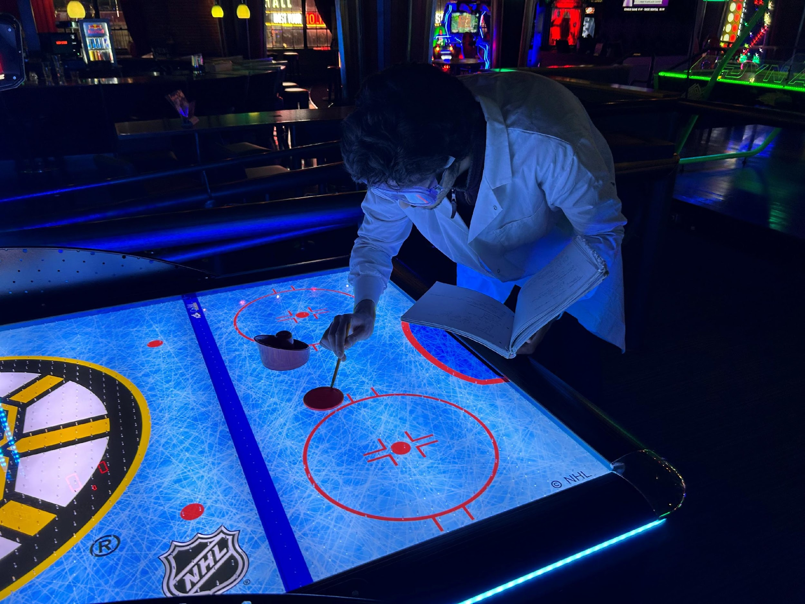
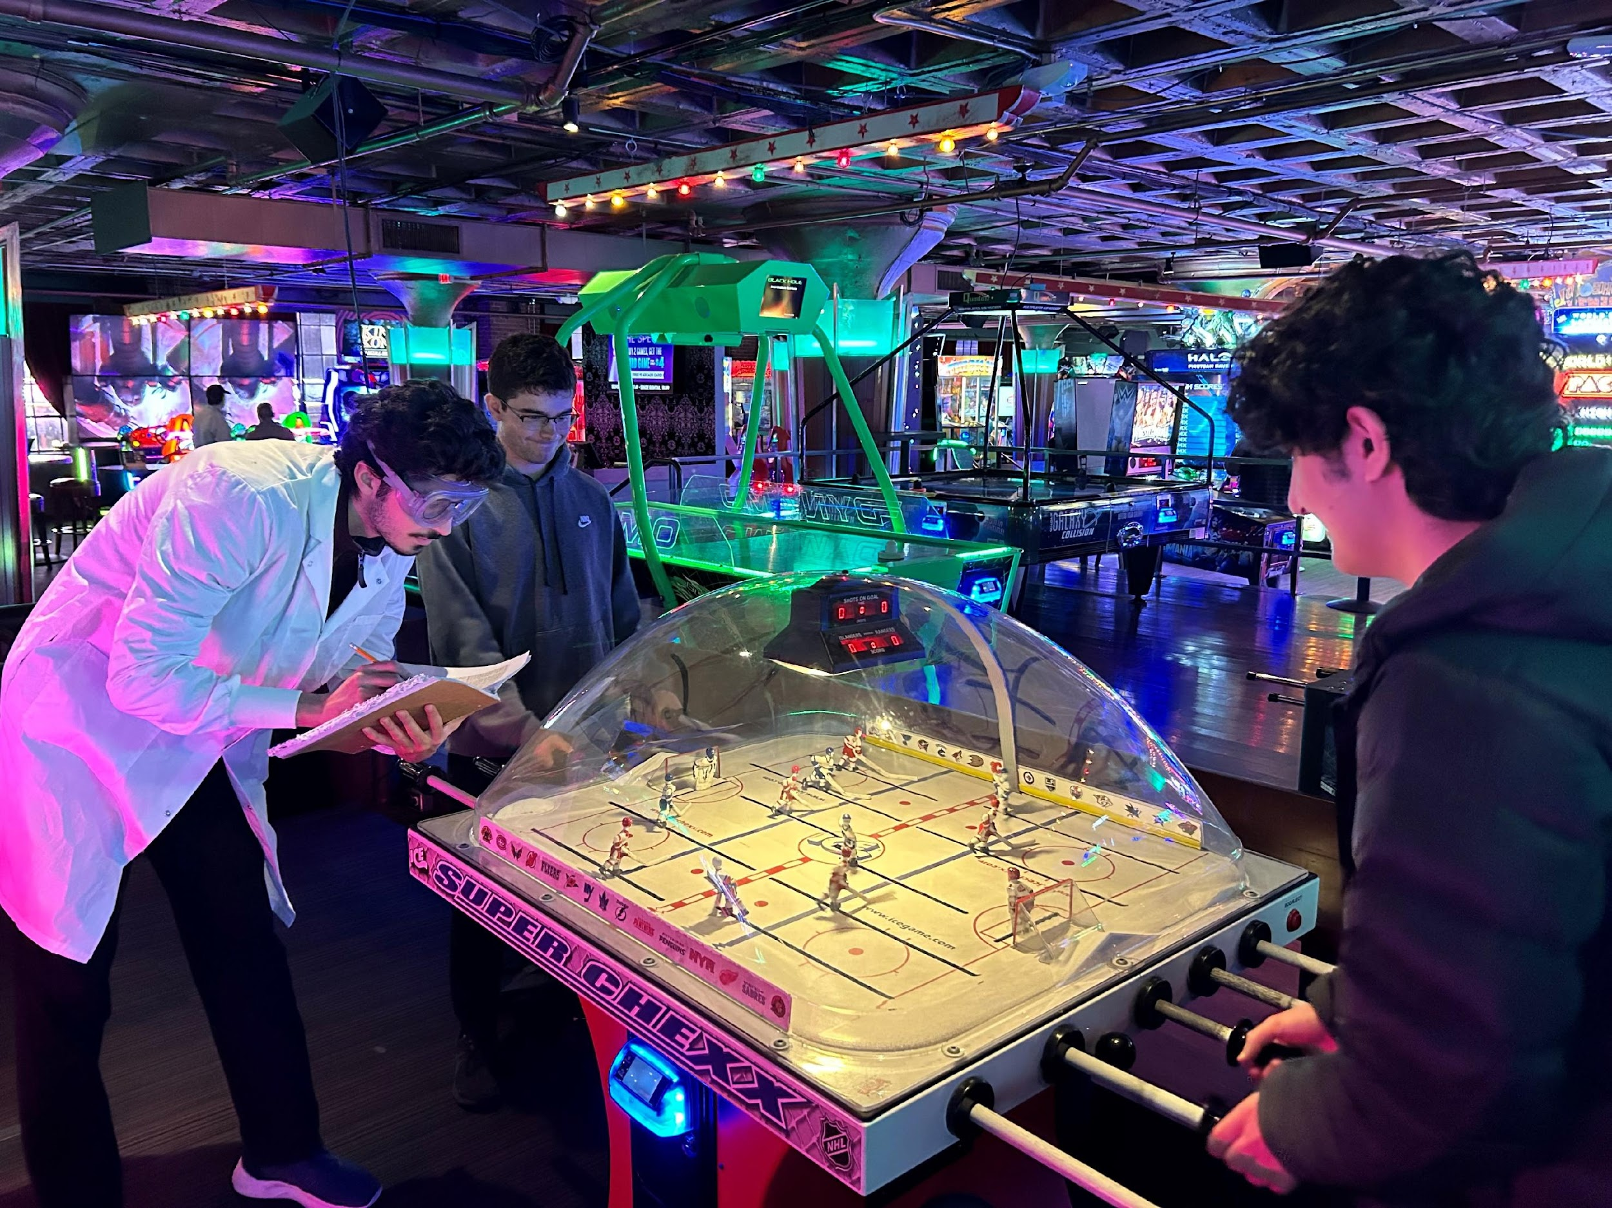
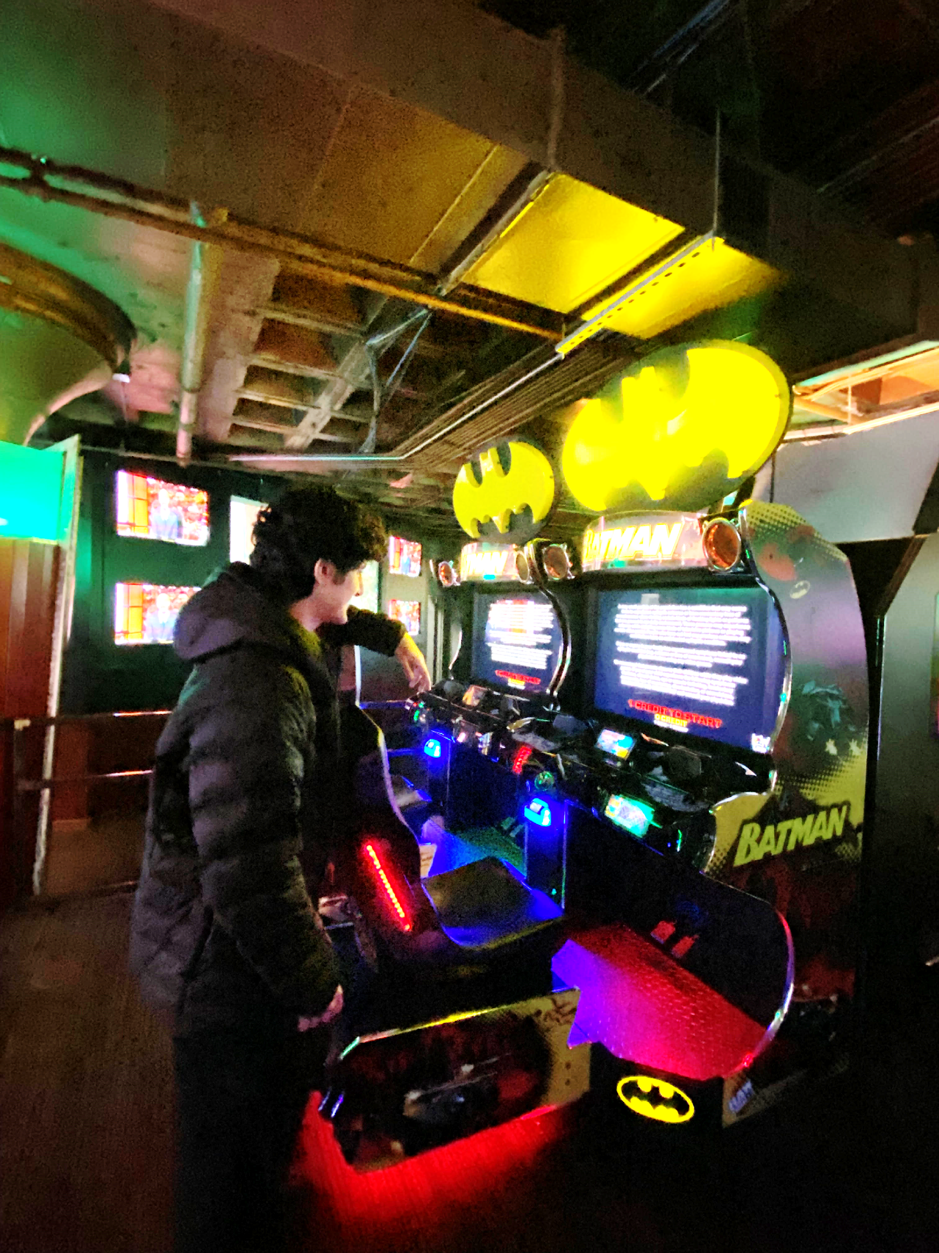
Critical Research
B U

Slide 6
GAME OVER
Block
Diagrams
7
5
Clock Divider
VGA
GO screen
Player Motion
User input
1kHz
1ms
RGB
Pixel x,y
Lettermap
Keyboard
Y, x pos.
TOP
Keycode
Pos, state
Menu screen
Puck States
Player Pos.
Seven Segment
1kHz

Slide 7
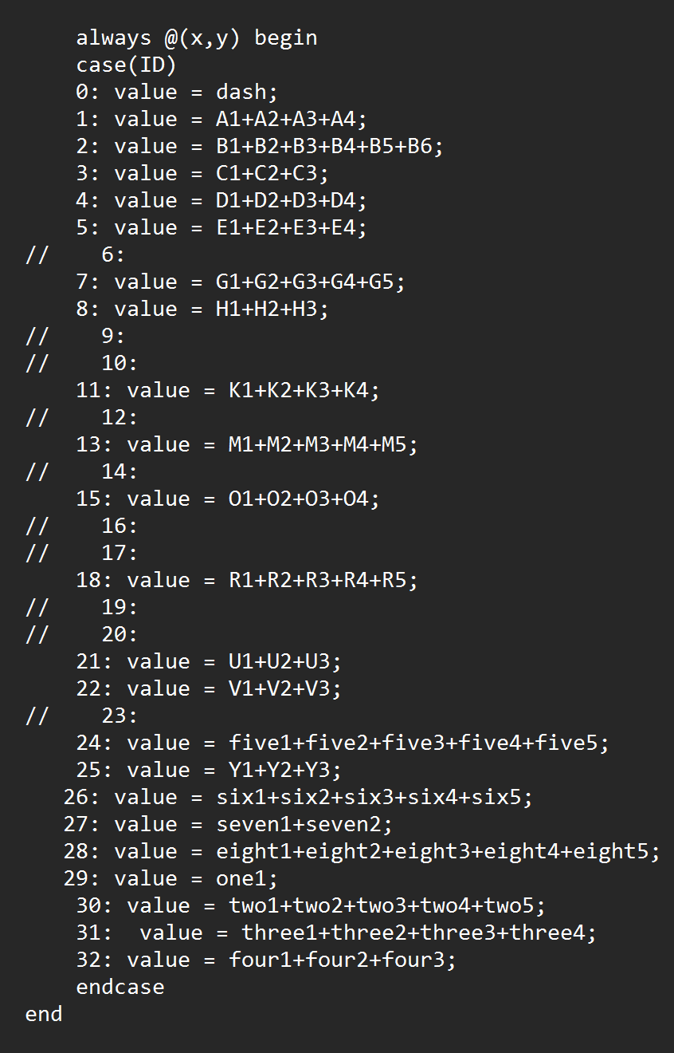
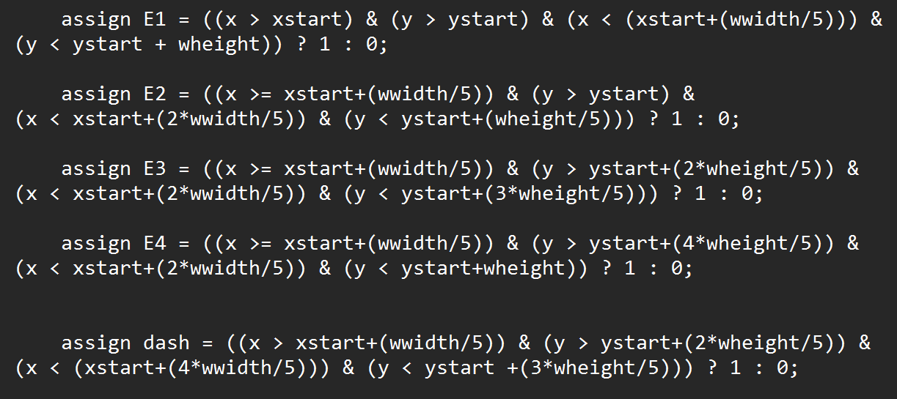
MENU MODE 1
Code
Snippet 1: Letter map

Slide 8
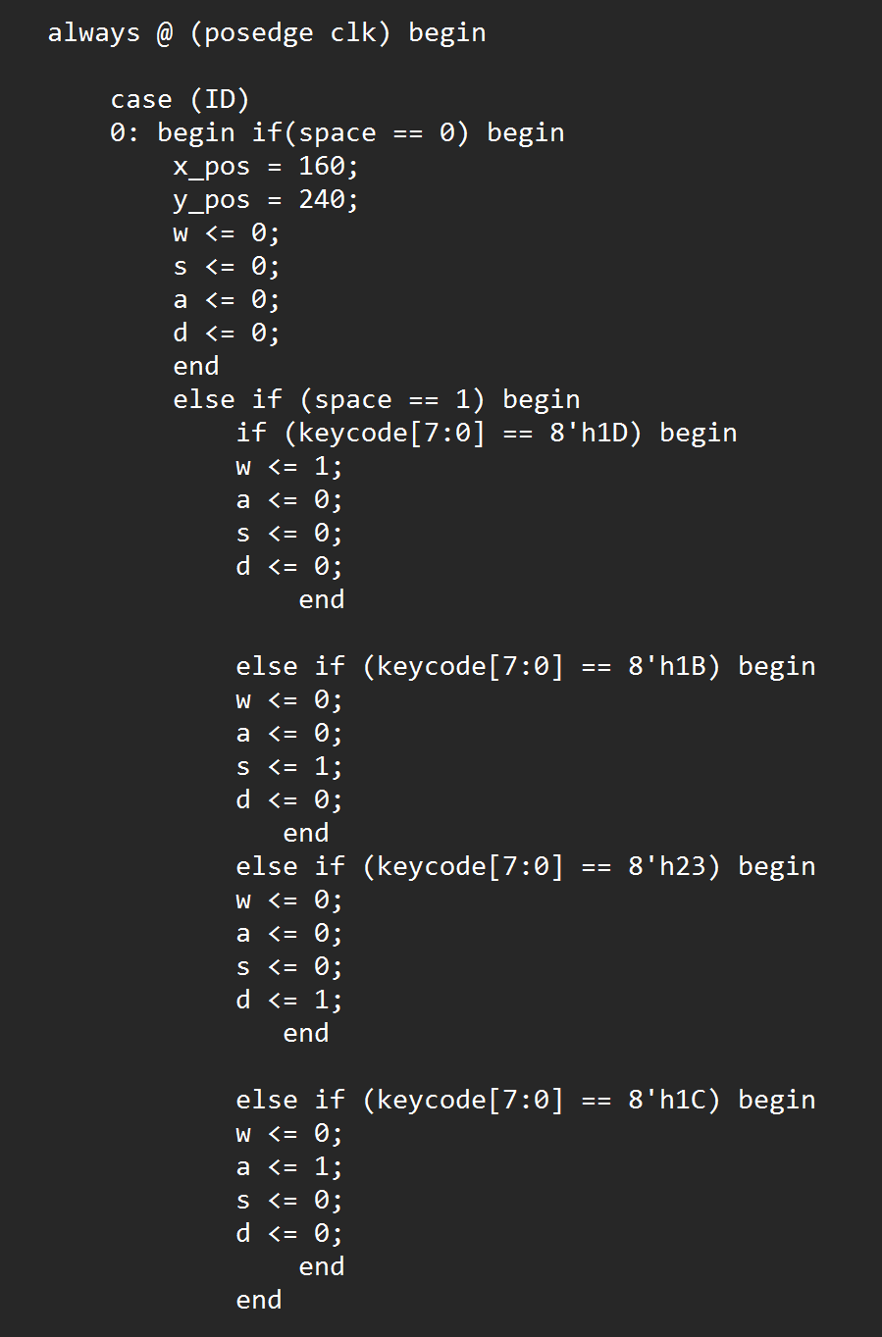
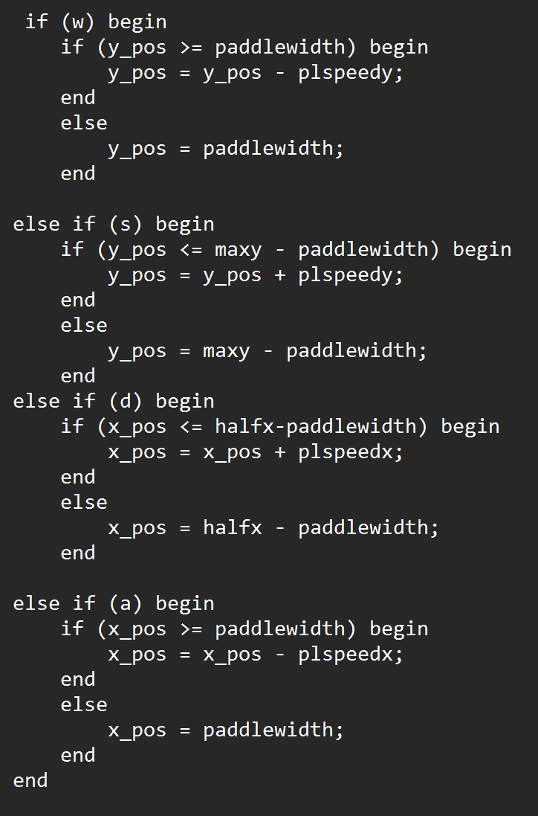
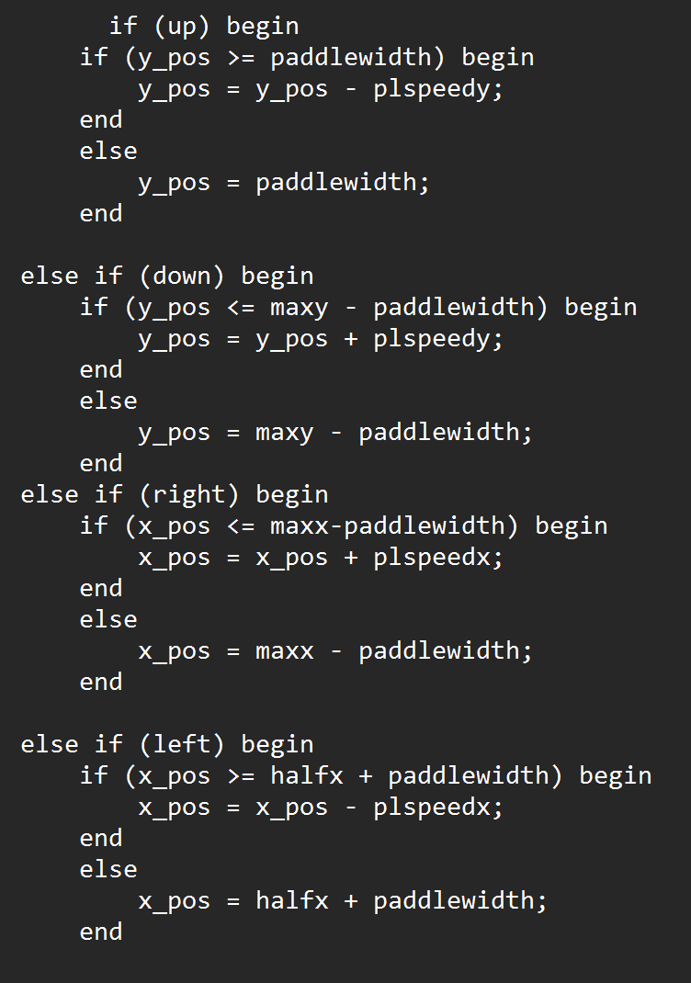
MENU MODE 2
Code
Snippet 2: Player motion
Right Player 🡪
🡨 Left Player

Slide 9
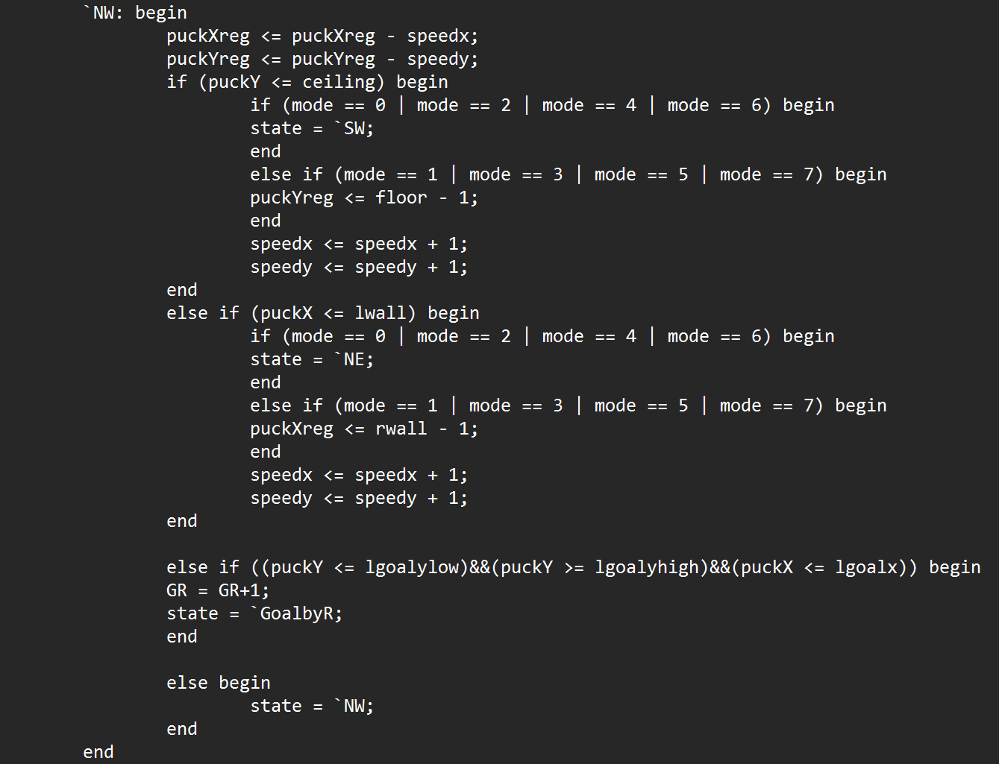
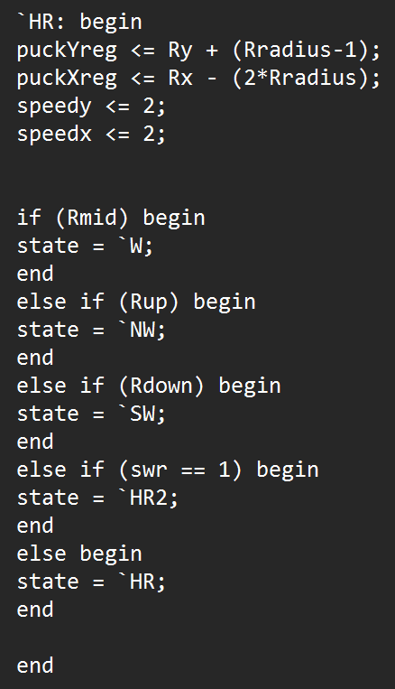
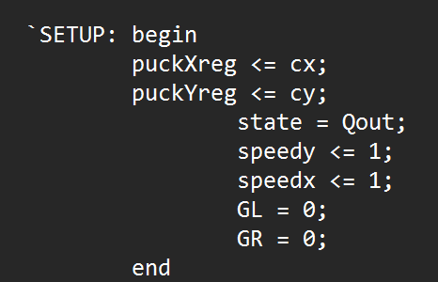
MENU MODE 3
Code
Snippet 3: Puck FSM

Slide 10
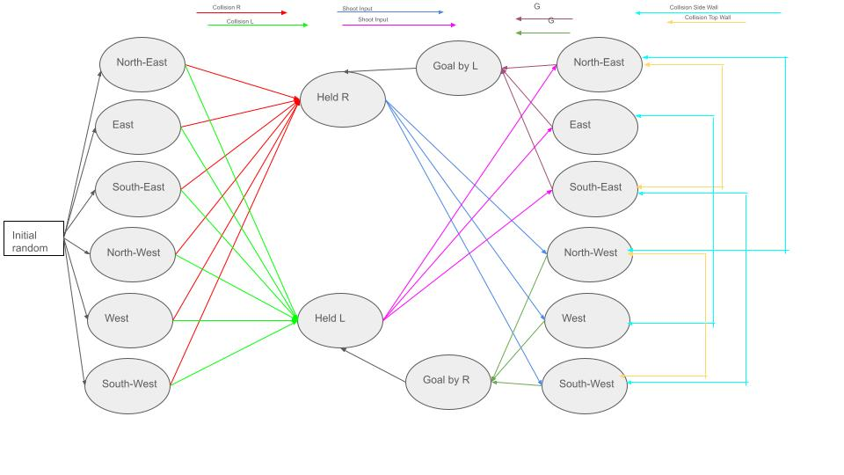
MENU MODE 4
FSM

Slide 11
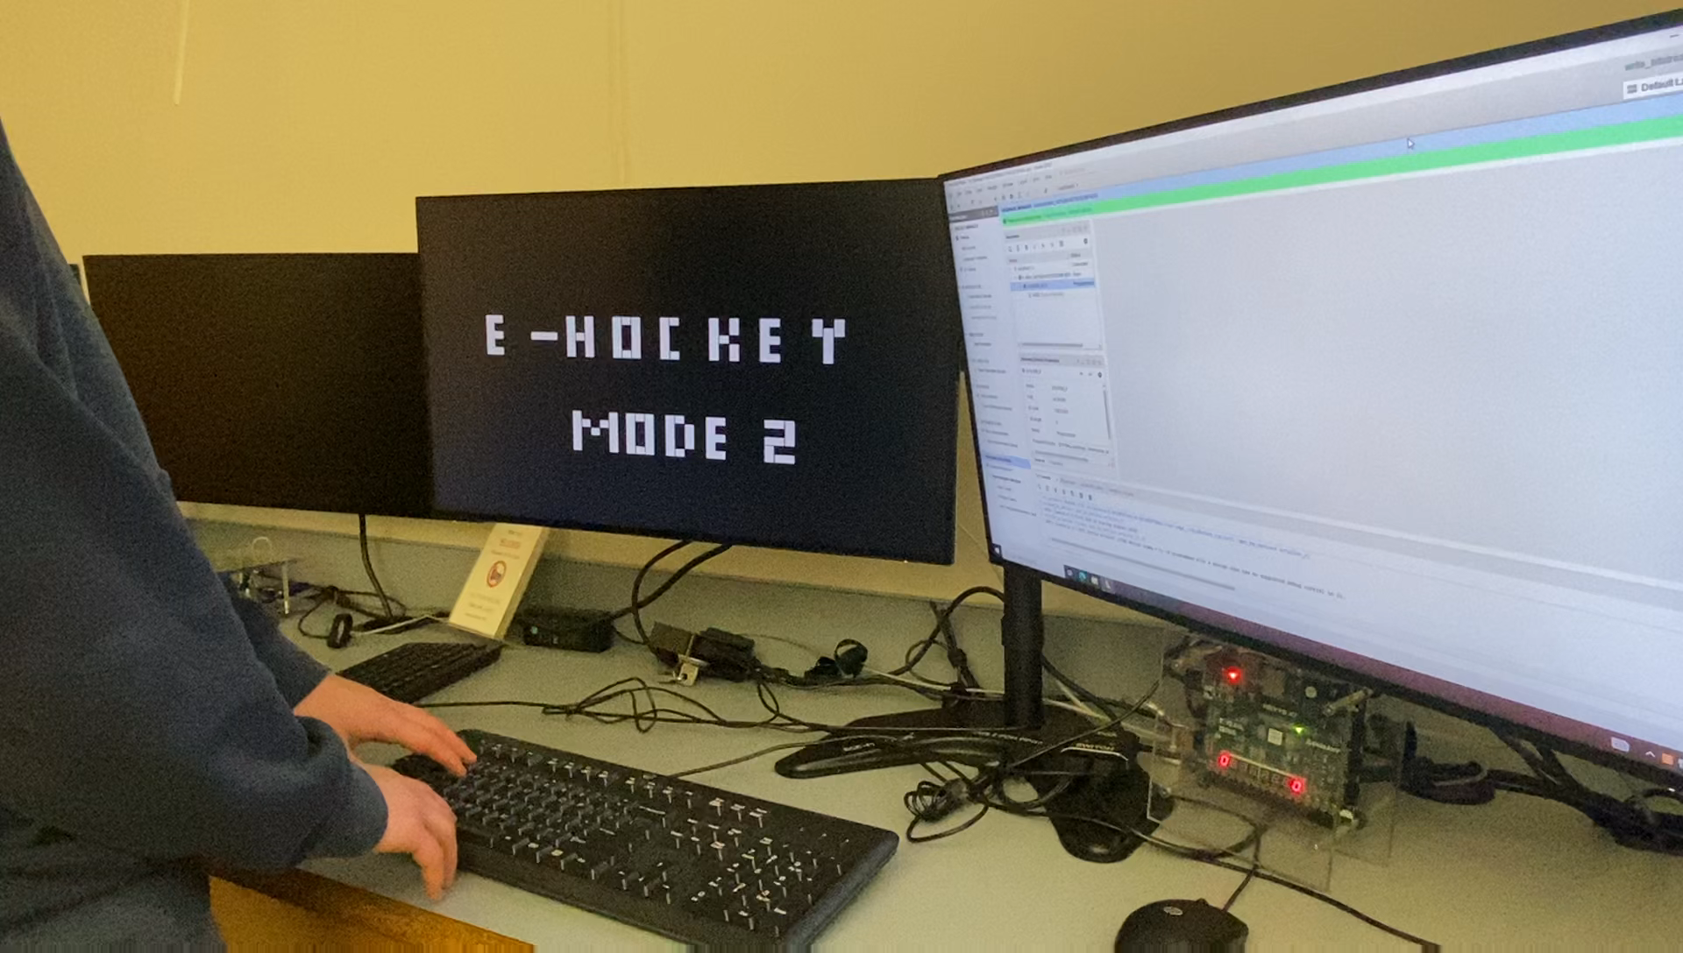
MENU MODE 4
Game function

Slide 12
Successes
START
B U
The major success of this project is the completion of all the gameplay functionalities allowing full games to be properly played comfortably.
Secondary goals were also achieved with the addition of multiple modes and the addition of more complex shooting.

Slide 13
Failures
B U
The project was limited by the language and hardware, acting as a soft ceiling for what could reasonably be achieved.
But, given more time we would’ve liked to explore the limits further, adding more variables and players into the game.
Another detail we hoped to expand were the sprites, which due to time limitations had to be limited to simpler shapes.

Slide 14
Questions?
B U

